Slide 1

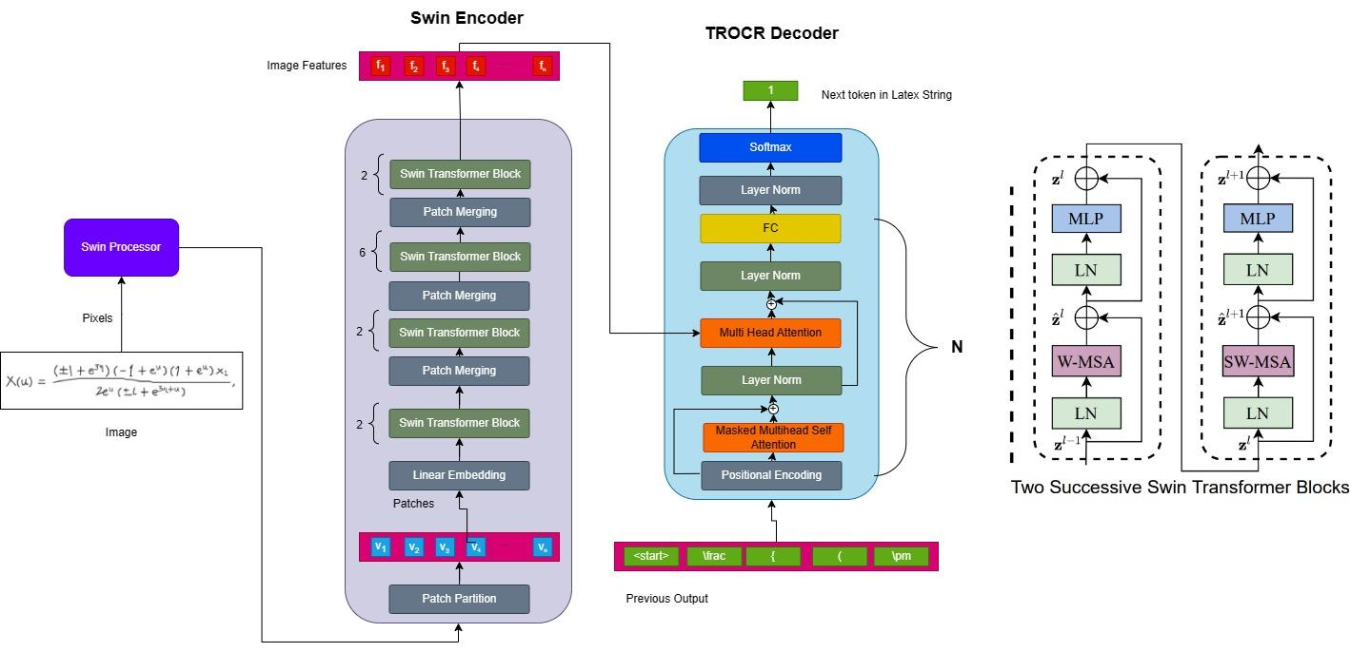

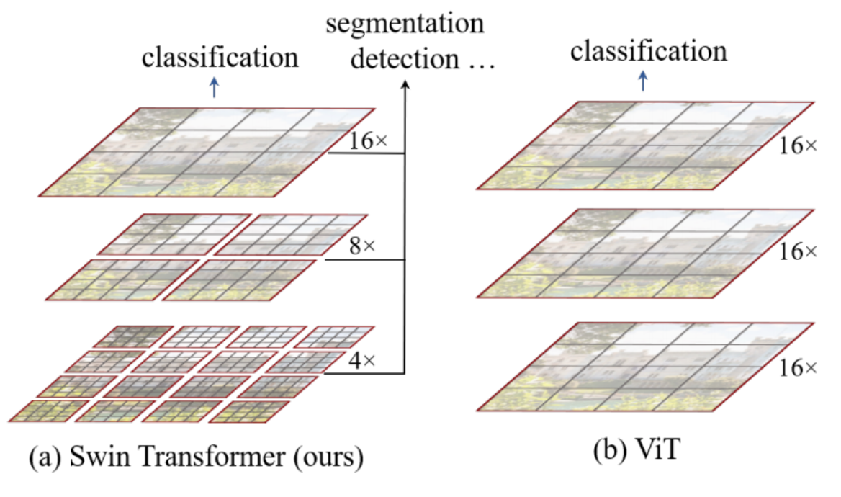
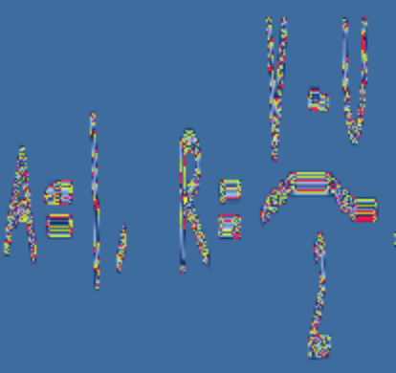
SwimNet: A Shifting Window Transformer for Translating Written Mathematical Expressions
Charles Immendorf ¹, Liam Chu ¹, Davin Seju ¹
¹ University of Washington
Introduction
Model
Automatically translating handwritten symbols into text has gained significant traction in the past few years with the popularization of deep learning models.
Popular need for converting an image of math symbols into the corresponding LaTeX.
RNNs, CNNs, and LSTMs are very popular for this task – not much exploration with transformers yet.
Model architecture employs the use of:
Swin Encoder pre-trained on ImageNet-1k.
TrOCR Decoder
Swin Encoder generates image patches within sliding window, helping it build “hierarchical feature maps by merging these image patches.”
Typical ViT generates patches over the entire image and produces feature maps over the entire image.
Swin has O(n) computational complexity with respect to image size vs O(n²) for ViT.
Data
Utilized Im2Latex-100k data set, which comes with ~103k image and latex formula combinations.
{ \\cal M } ( \\theta ) = \\left( \\begin{array} { cc } { \\operatorname { cos } \\theta } & { \\operatorname { sin } \\theta } \\\\ { - \\operatorname { sin } \\theta } & { \\operatorname { cos } \\theta } \\\\ \\end{array}
Processed images using Microsoft Swin processor to prepare images for classification.
Results
Error function is Word Error Rate (WER) which penalizes based on entire words as opposed to characters. Preferred method in NLP.
Trained with masked language modeling loss
Word Error Rate of other models
State of the Art: CNN Encoder + LSTM decoder; WER = 0.20
Our Model
Trained for 5 Epochs
Training Size: 68k images + formulas
Validation Size: 8500 images + formulas
Test Size: 8500 images + formulas
Train Loss: 2.283
Validation Loss: 2.191
Validation WER: 0.702
Diagram provided by Liu et. al.
Actual output that we generated from Swin processor

